Slide 1
IR Radiation Characteristics of Rocket Exhaust Plumes under Varying Motor Operating Conditions
Niu. Qinglin et al., Chinese Journal of Aeronautics, Vol.30, No. 3, pp.1101-1114, 2017
2024.05.13
김진성

Slide 2
Table of Contents
Introduction
Physical Models
Numerical method
Results
Conclusions

Slide 3
Table of Contents
Introduction
Physical Models
Numerical method
Results
Conclusions

Slide 4
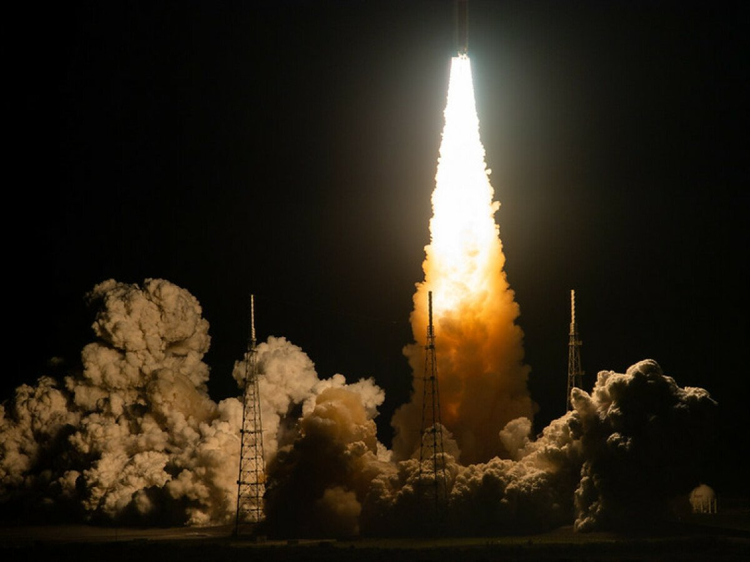
1. Introduction
The rocket motor exhaust plume is a major source of infrared radiation signals in flying vehicles.
Rich gases are emitted through the nozzle and interact with the surrounding air.
In this process, some oxygen is drawn into the plume, and combustion reactions continuously occur in the mixing layer, significantly increasing the temperature and radiation intensity of the plume.
It is important to understand the infrared radiation characteristics occurring in the exhaust plume of a rocket motor and to analyze them under various motor operating conditions.

Slide 5
1. Introduction
In this study
The object is to develop an efficient model for the prediction of exhaust plume IR spectral radiation characteristics within the wavelengths of 1.50~5.50 µm.
This paper discusses the effects of changes in three operating conditions.
Afterburning for an under-expanded supersonic jet
Ignition and cutoff with a variety of chamber pressure
Propellant ingredients for minor changes in the ratio of HTPB binder to AP oxidizer

Slide 6
Table of Contents
Introduction
Physical Models
Numerical method
Results
Conclusions

Slide 7
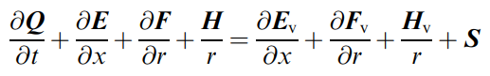
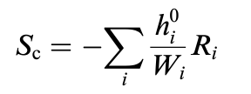
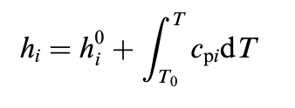
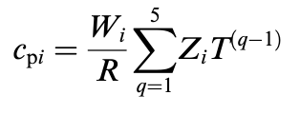
2. Physical models
Governing equations
Q : conservative vector
E,F,H: convective variables
E_{v,} F_{v,} H_{v} : viscous flux vector
S : source term
The axisymmetric form for the Navier-Stokes equation
Chemical Source Term
W_{i} : molecular weight
R_{i} : gas constant of i th species
R : universal gas constant
Z_{i} : denotes polynomial coefficients

Slide 8
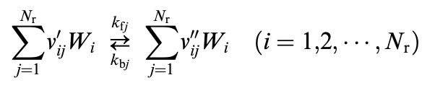
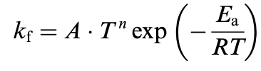
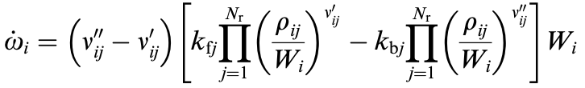
2. Physical models
Turbulence model
Using k-ε-R_{t} turbulence model
Chemical afterburning model
Finite-rate chemistry reaction

Slide 9
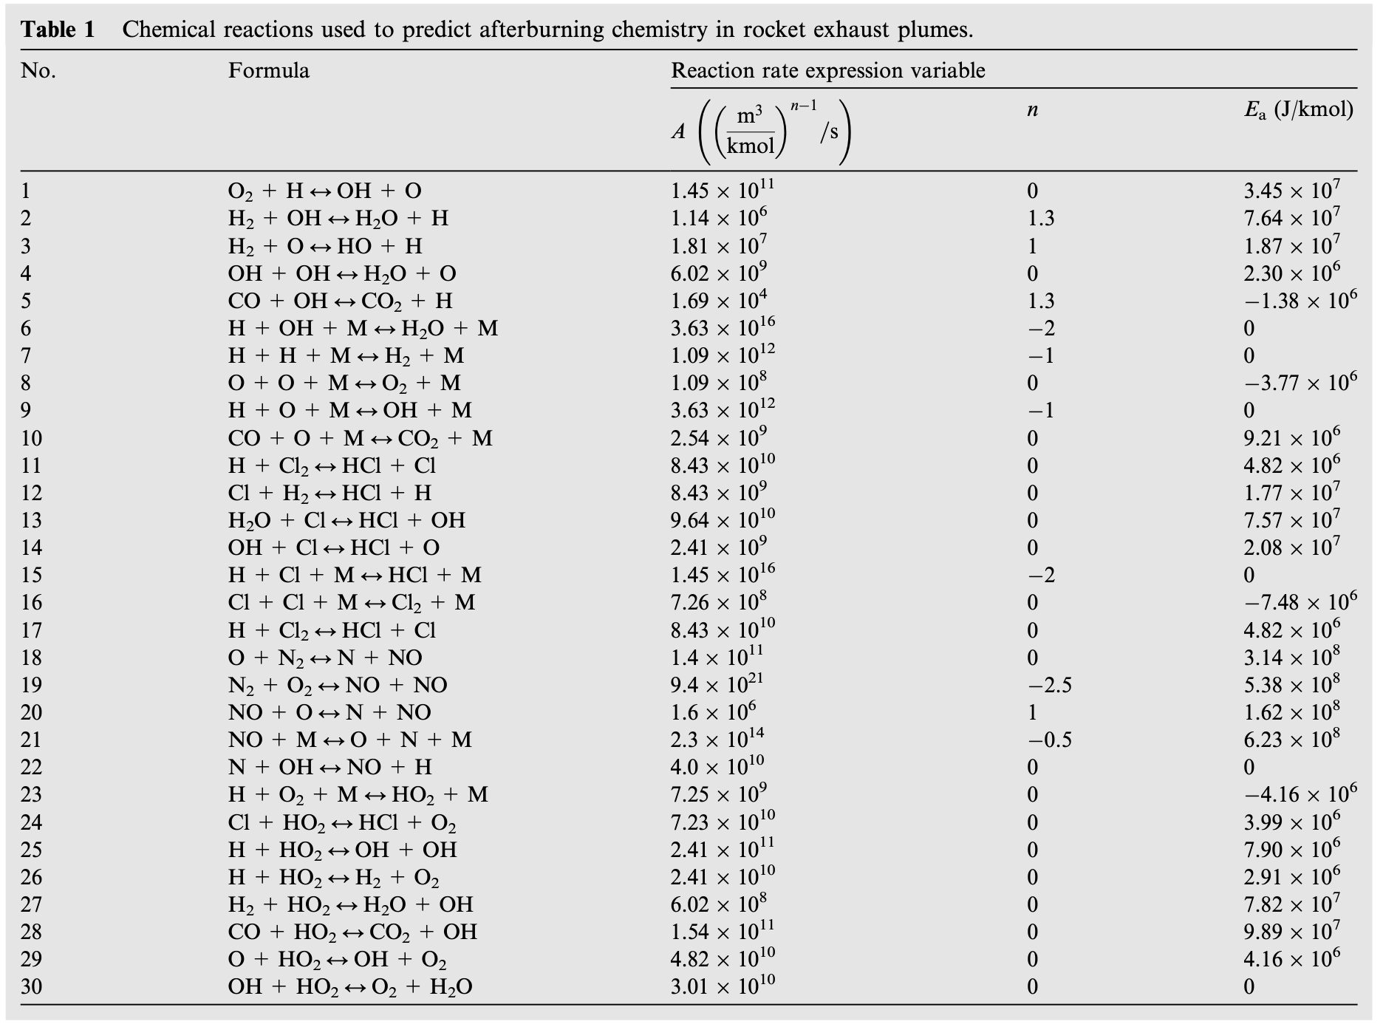
2. Physical models
Chemical afterburning reaction
13-species and 30-reaction chemistry scheme

Slide 10
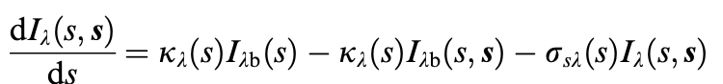
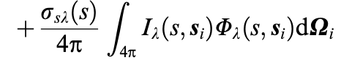
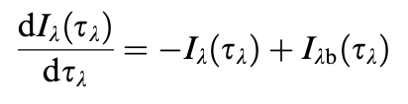
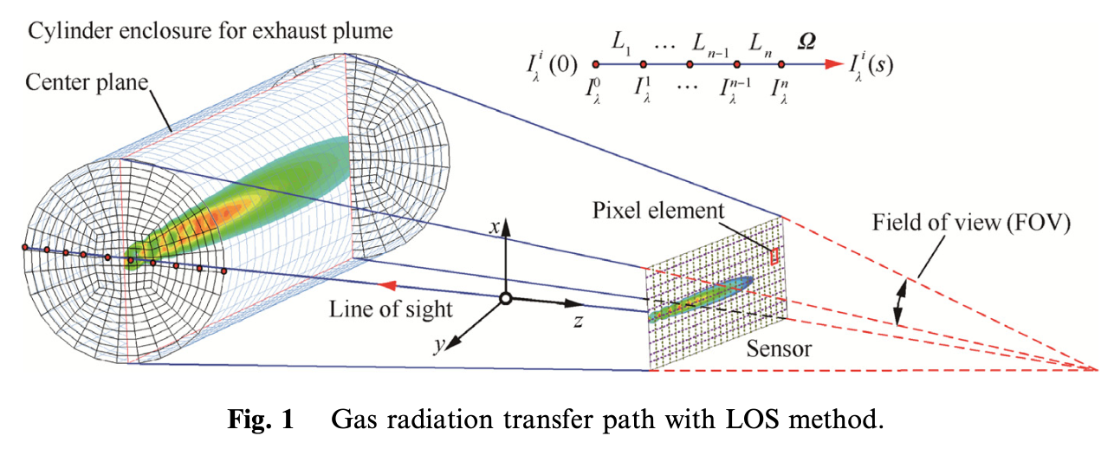
2. Physical models
Infrared radiation transfer model
The radiant intensity of the exhaust plume results from three effects.
Spectral emission lines determined by the composition and temperature of the gases
Broadband(Planck) radiation determined by the temperature of the gases
Spectral absorption of the radiance by the plume itself

Slide 11
Table of Contents
Introduction
Physical Models
Numerical method
Results
Conclusions

Slide 12
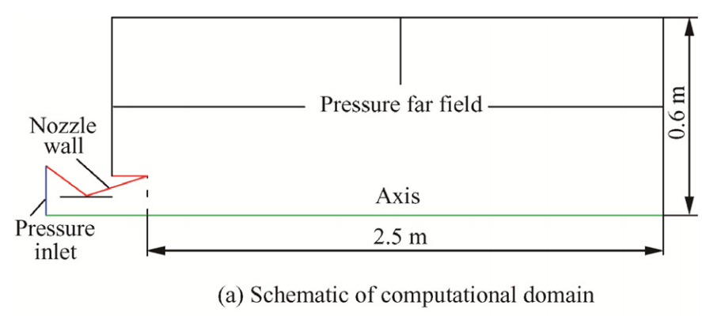
3. Numerical method
Computational domain
BEM-2 motor

Slide 13
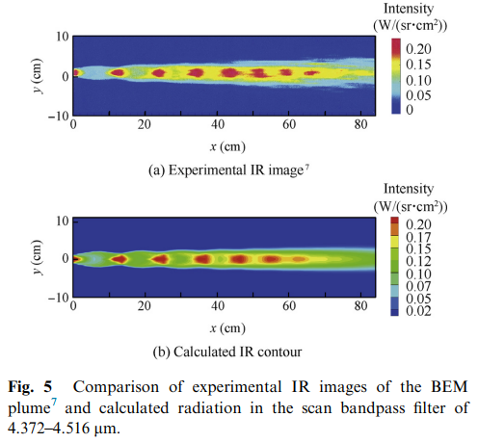
3. Numerical method
Validation of the infrared radiation code
BEM-2 motor
The calculated values of infrared emissions predicted based on the plume's flow field were compared with experimental values.
The distribution of 'diamonds' and the radiance intensity of the calculated infrared images show a good match with the measured results.

Slide 14
Table of Contents
Introduction
Physical Models
Numerical method
Results
Conclusions

Slide 15
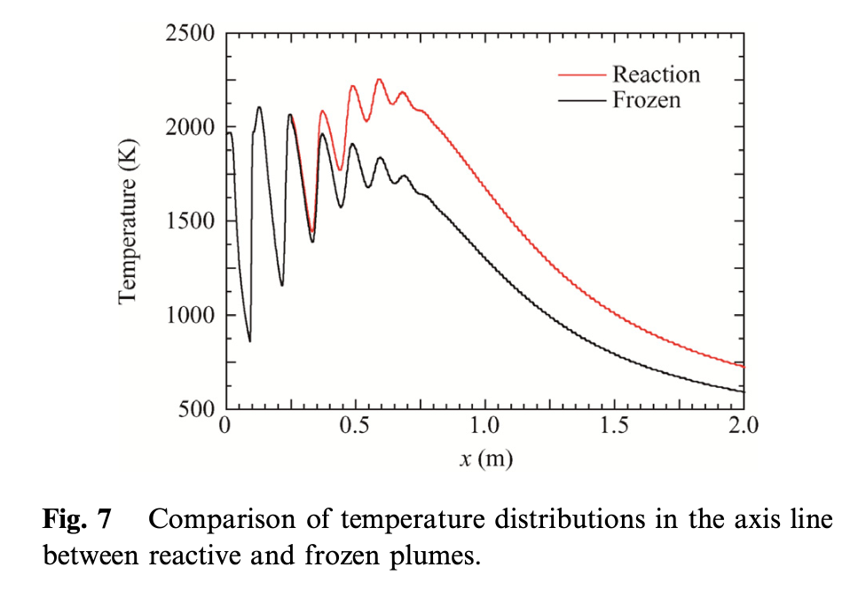
4. Results
Effects of afterburning (1/4)
The temperature distribution matches up to 0.3m. This is because the area is the jet core.
The average temperature is 200 to 300 K higher in reaction than in frozen.
Several peaks in the temperature profile are caused by shock cells.
Subsequently, the temperature converges to the ambient temperature.

Slide 16
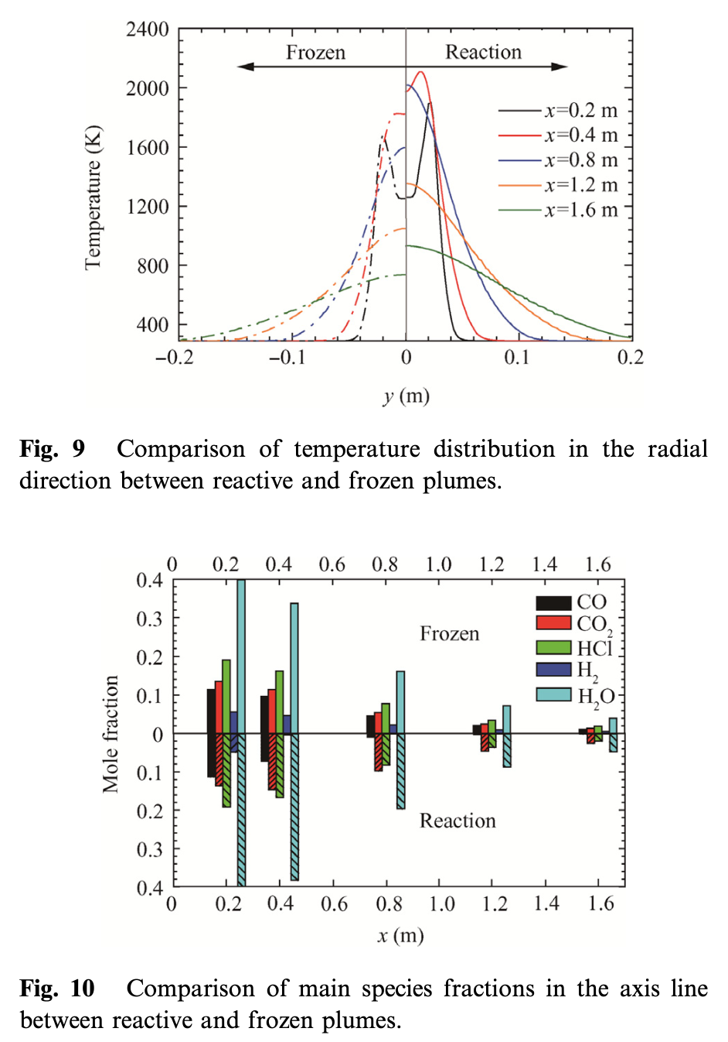
4. Results
Effects of afterburning (2/4)
Significant changes are observed in the far field area.
In the far field, as the exhaust gases rapidly mix with ambient oxygen, the afterburning effect causes higher temperatures compared to the frozen plume.
CO2 and H2O increase as H2 and CO mix react with the ambient air.

Slide 17
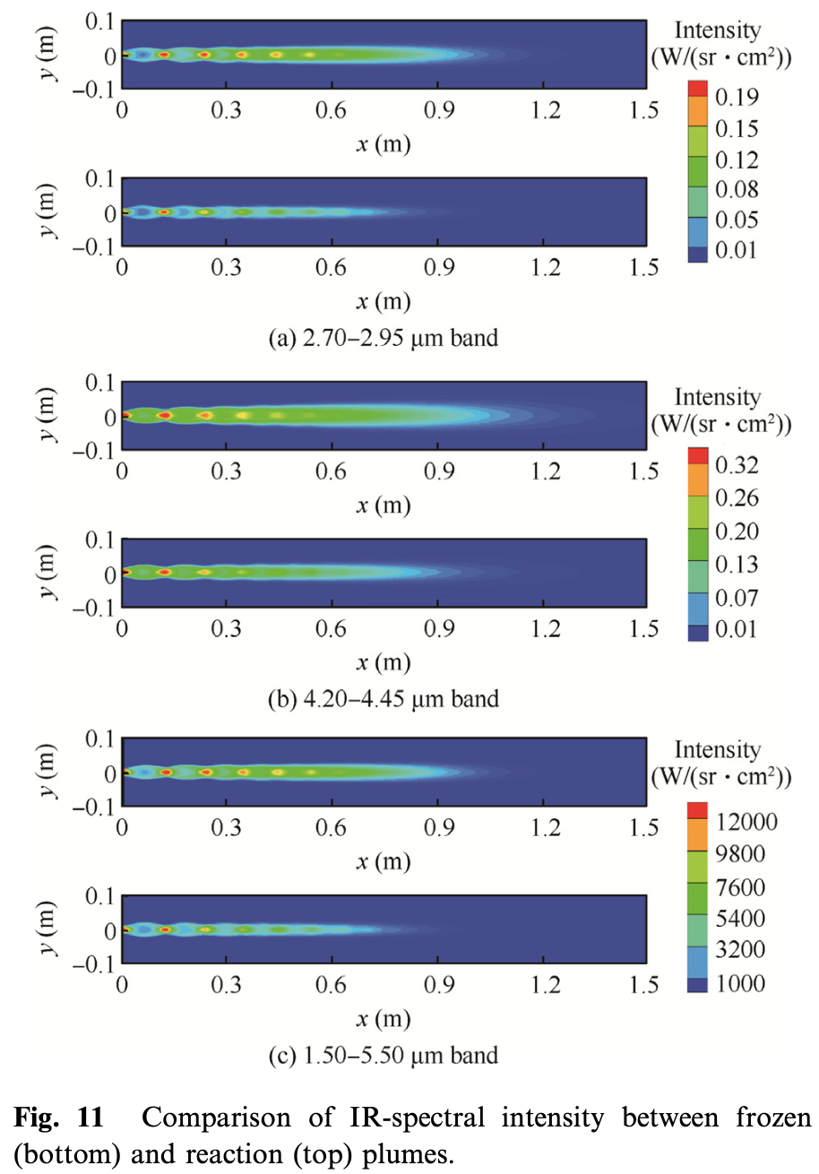
4. Results
Effect of afterburning (3/4)
The figures show that the brightest diamonds appear at high gas temperatures.
In the bright diamonds, there is a high molar concentration of the major species, H2O and CO2, which shows a distinct increase in the reaction plume.
The molar fraction of each species, except for O2 and N2, always decreases due to the influx of atmospheric air.

Slide 18
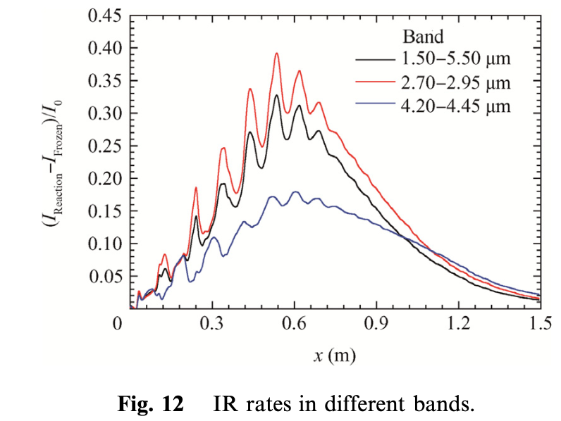
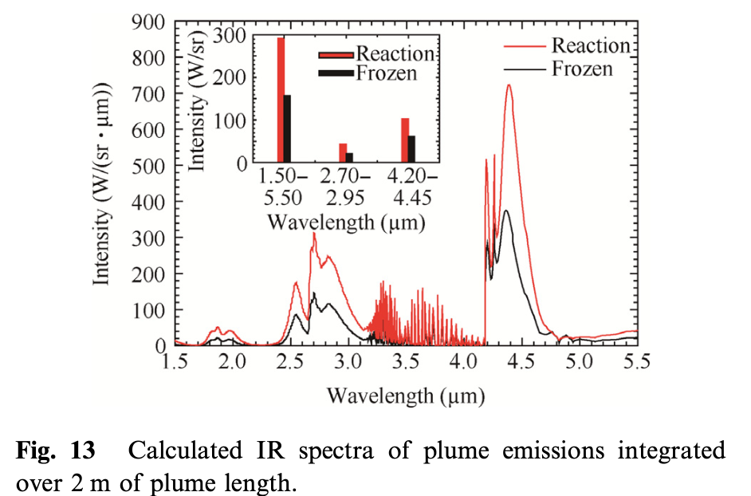
4. Results
Effect of afterburning (4/4)
The Radiation caused by the afterburning effect primarily occurs in the transition and far field.
IR Significant changes can be observed in the area between 0.2m and 0.6m, with the maximum value occurring at 0.6m.
The highest increase in radiation occurs at 2.7 µm and 4.3 µm, which is due to the influence of H2O and CO2.

Slide 19
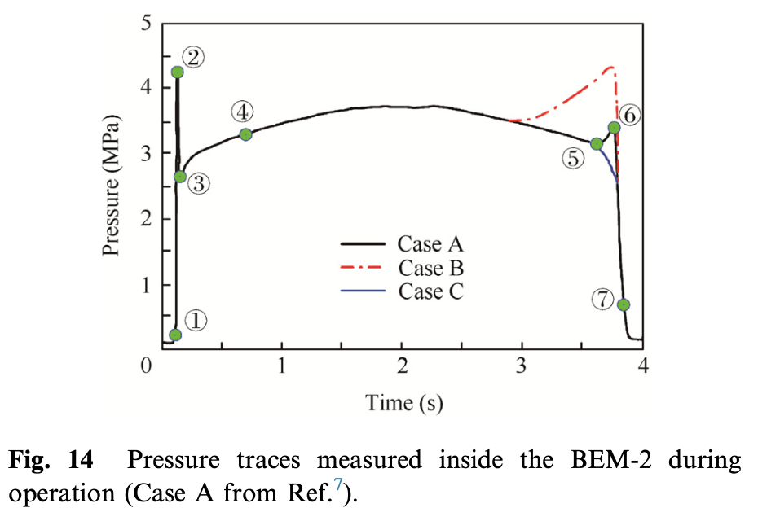
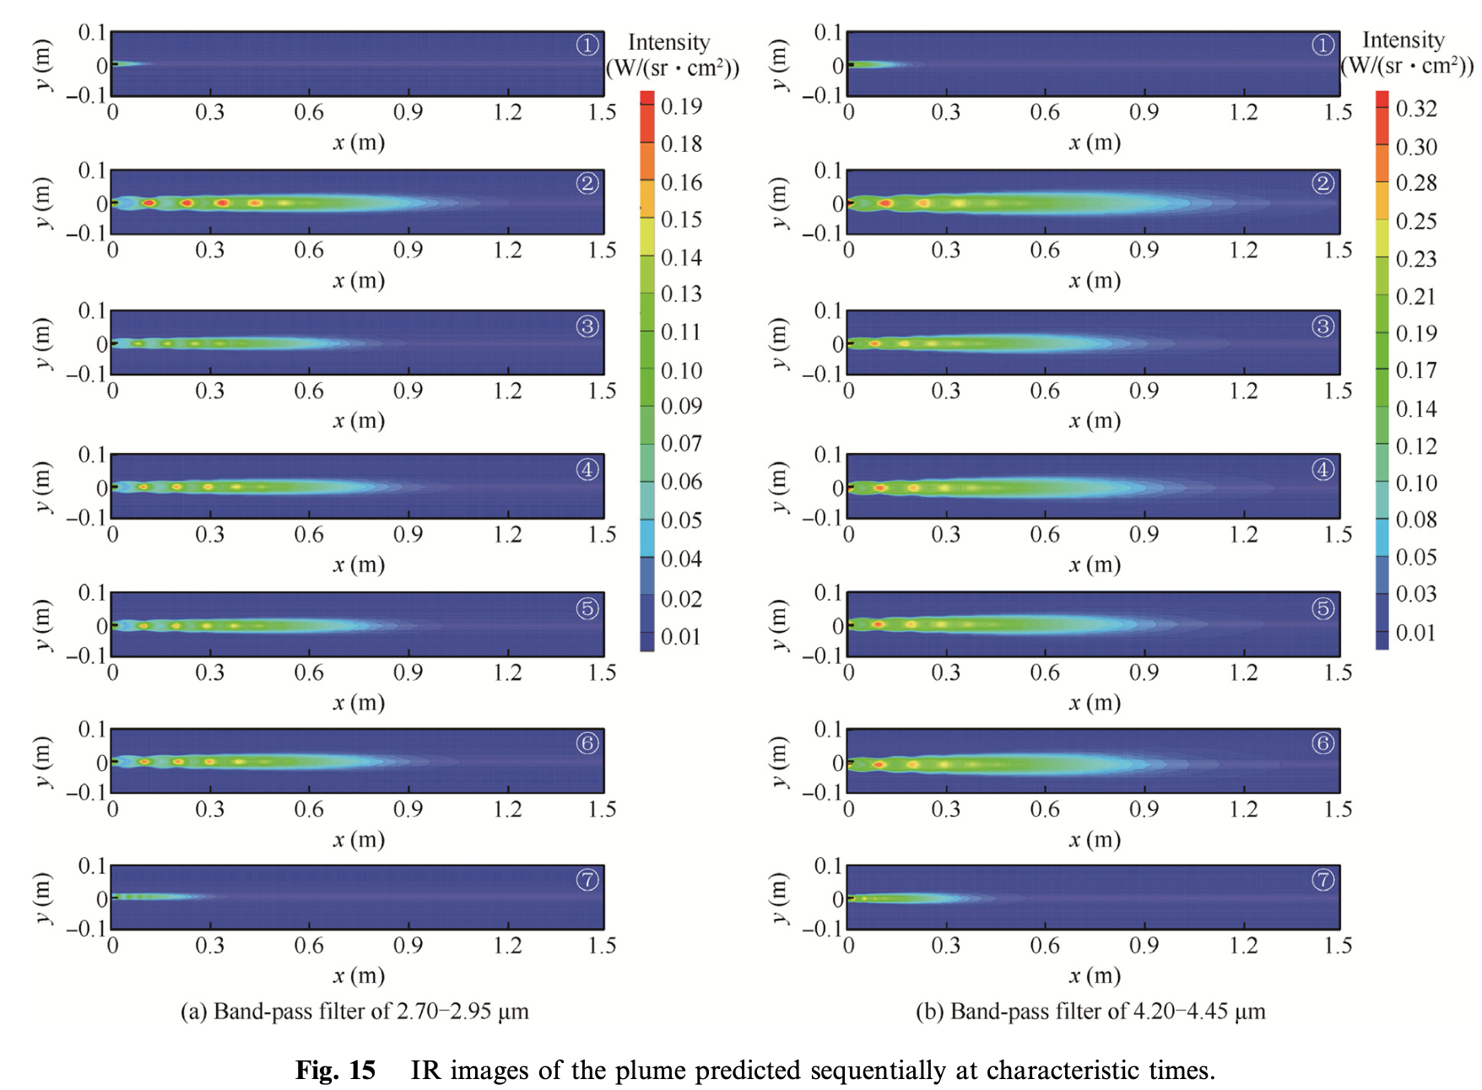
4. Results
During ignition, a large amount of gaseous combustion products are instantly generated, forming a pressure peak much higher than usual.
At point 2, the IR irradiance intensity is higher compared to other cases, and it is approximately 20% longer than the baseline case.
The structure of the plume changes because the increase in pressure raises the gas velocity and the static pressure at the nozzle exit.
Changes in chamber pressure during engine ignition and cutoff significantly affect the IR irradiance of the rocket exhaust plume.
Effects of ignition and cutoff on the plume signature (1/3)

Slide 20
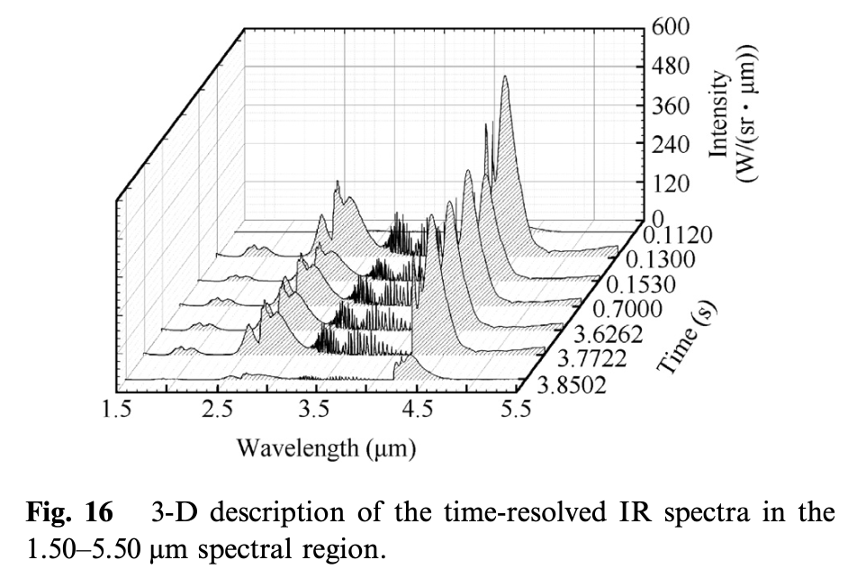
4. Results
Effects of ignition and cutoff on the plume signature (2/3)
Pressure peaks during motor ignition result in higher IR irradiance.
In the 2.7 µm and 4.3 µm bands, it is 40.7% and 33.4% higher compared to the steady state, respectively.
As pressure increases, temperature rises and a change in the structure of the plume occurs.

Slide 21
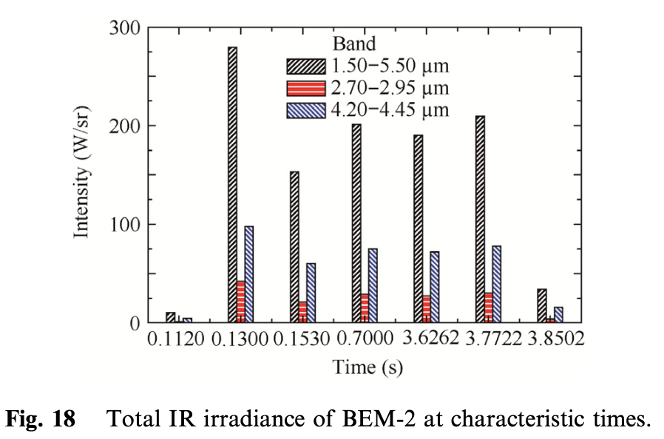
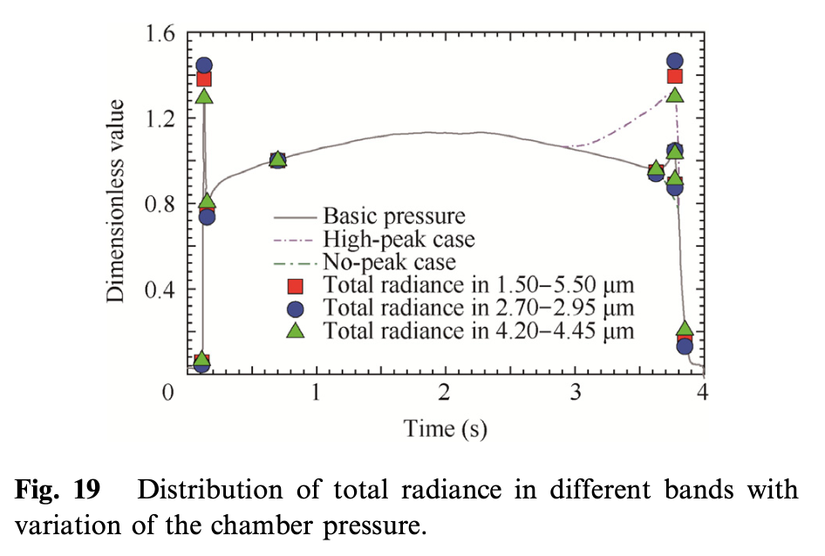
4. Results
Effects of ignition and cutoff on the plume signature (3/3)
The Mach number, pressure, and temperature contours of the four-engine rockets exhaust plume impinging on the wedge-shaped and cone-shaped deflectors are shown in Figs. 7 and 8.
Under the combined effect of external air and high unexpanded exhaust gas, a clear structure of the first shock cell can be observed near the rocket gas field.
Second shock cell-like structure is less clear due to the interaction of the four equal plumes.

Slide 22
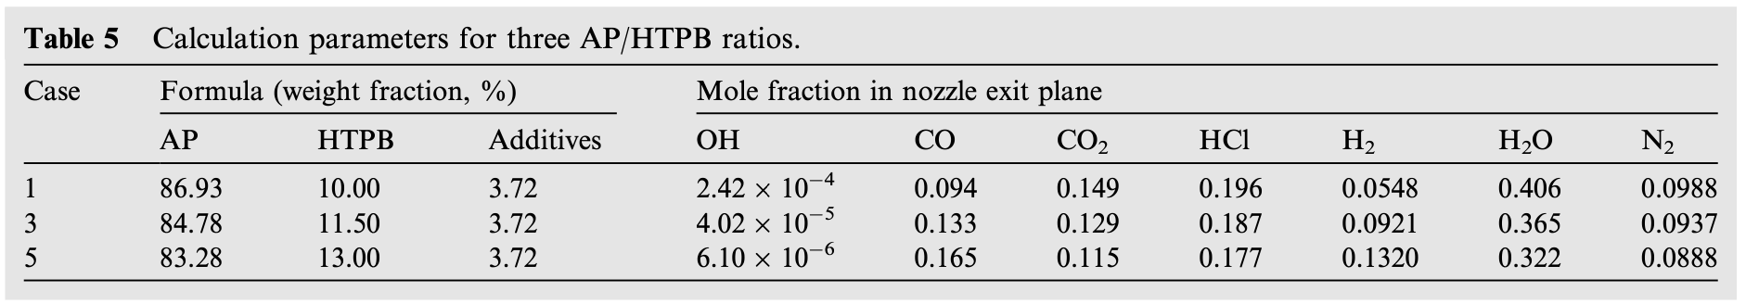
4. Results
Effects of propellant ingredients (1/3)
Five cases were set by increasing the mass fraction of HTPB by 0.75% each, and only three of them are shown.
In all cases, thermal properties of mixed gases from the chamber to the nozzle exit are computed by the Chemical Equilibrium with Applications (CEA) code.

Slide 23
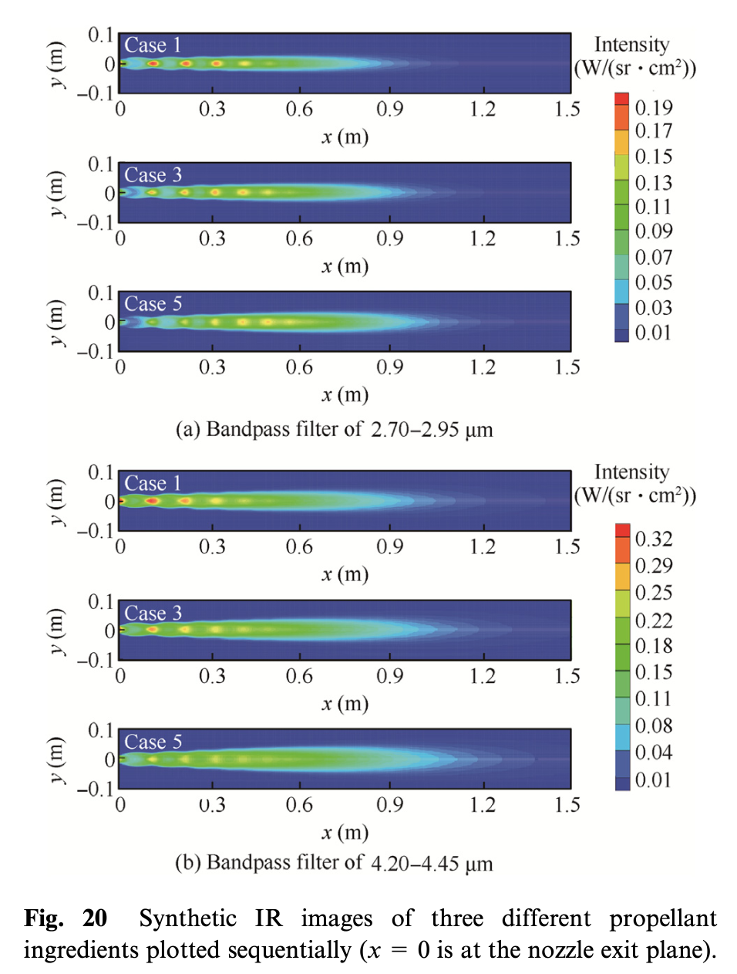
4. Results
Effects of propellant ingredients (2/3)
Increase HTPB by 1.5%
The maximum intensity decreases and the radiance area also expands.
The brightest diamonds move backward away from the nozzle exit, and the distribution of other bright diamonds varies according to the location of shock cells.
The level of diamonds near the exit declines more obviously with each increment of HTPB.

Slide 24
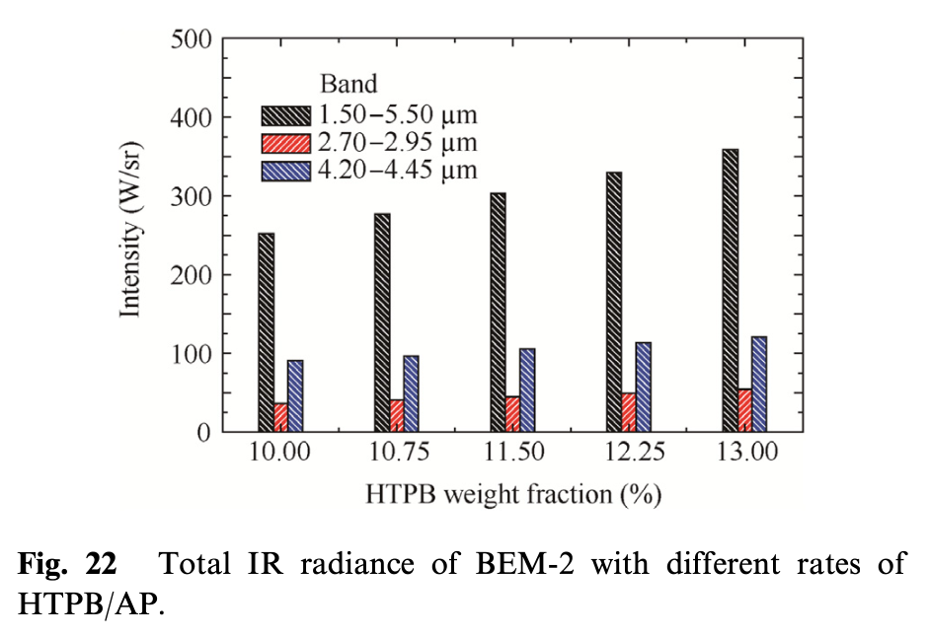
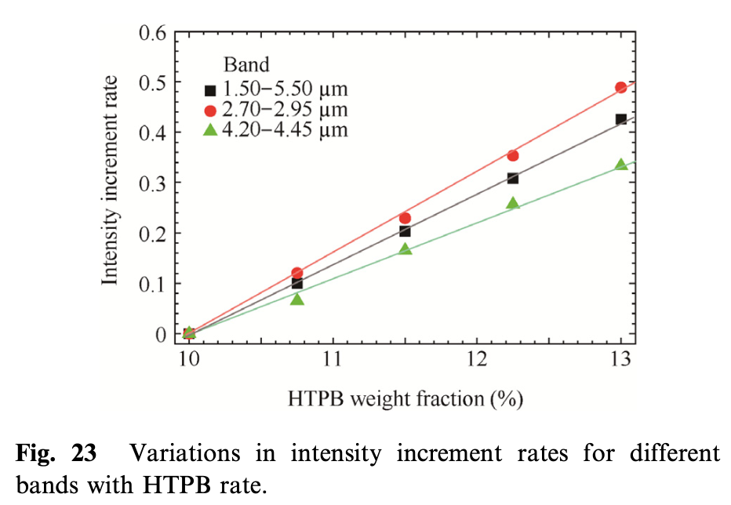
4. Results
Effects of propellant ingredients (3/3)
Radiance intensities in three bands (1.50–5.50 µm, 2.702.95 µm, and 4.20–4.45 µm) with ﬁve selected HTPB increments (10.00%, 10.75%, 11.50%, 12.25% and 13.00%) are calculated and presented in Fig. 22.
As can be seen from this ﬁgure, the increment rates of radiance intensity integrated in each band are linear with increase in HTPB, and the growth rates of radiance intensities in three bands are 2.70–2.95 µm band, 1.50–5.50 µm band and4.20–4.45 µm band from high to low and reach up to 50%, 42% and 34%.

Slide 25
Table of Contents
Introduction
Physical Models
Numerical method
Results
Conclusions

Slide 26
5. Conclusion
Using the BEM-2 as a test platform for this research, the IRSAT was applied to discuss the following three effects on IR signatures under operating conditions:
Effect of afterburning
The length of the plume increase by 30%, and the intensity at the peaks of 2.7 µm and 4.3 µm increased.
The increase in IR radiation due to afterburning effects primarily occurs in the transition and far fields.
Effect of ignition and cutoff on the plume signature
An increase in chamber pressure lead to an incremental increase in IR irradiance intensity and scale.
It extended the spacing of the diamond shapes, moving the position of the first diamond backwards.
Effect of propellant ingredients
The radiance intensity in each band increases with the increase in HTPB.
As the HTPB/AP ratio increased, the maximum intensity decreased, but the total intensity increased.

Slide 27
Thank you

